Slide 1



Academic Communication In Geoscience
Department: Earth and Space Science
Instructor: Nanyu Wei
Term: Fall 2020-2021

Slide 2

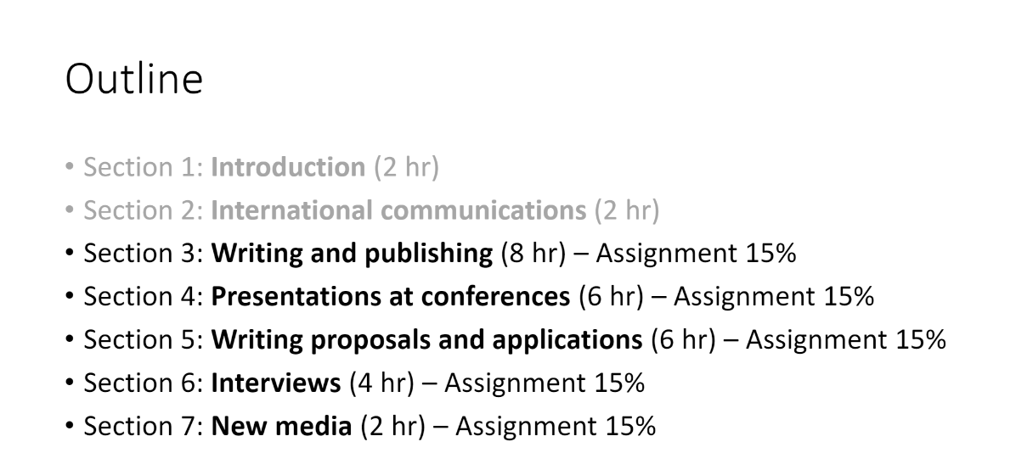

Slide 3
Title
Introduction
Author
Method
Ingredients in A good paper?
Address
Results
Abstract/ Summary
Conclusion/ Discussion
Acknowledgement
Reference

Slide 4
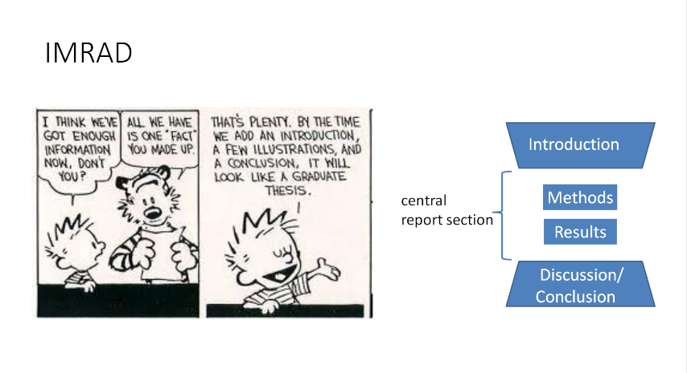

Slide 5
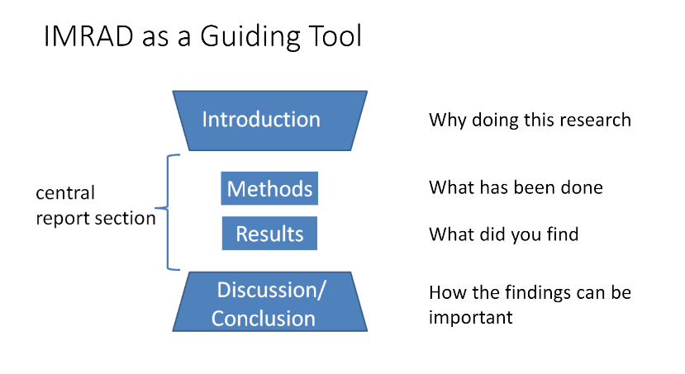
ABOUT LAST week

Slide 6
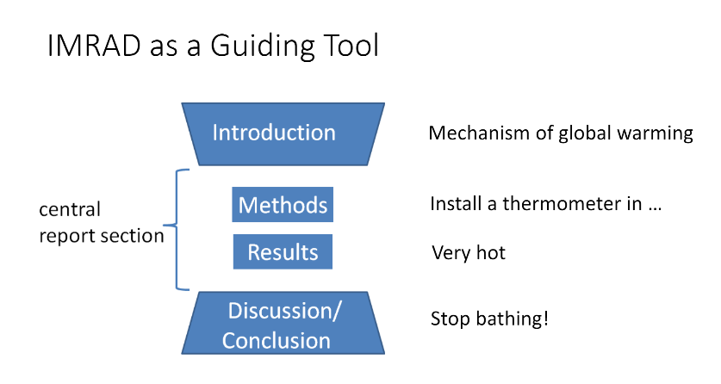
ABOUT LAST week

Slide 7
Let’s do a practice
SUMMARY
THEORY
CONCLUSIONS
Discussion
INTRODUCTION
Results
EXAMPLES
REFERENCES

Slide 8
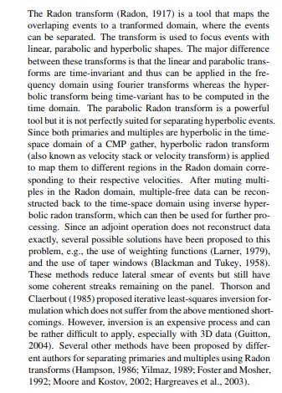
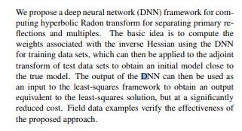
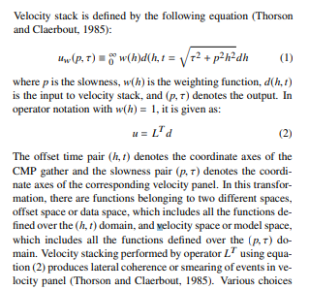
1.SUMMARY
3.THEORY
2.INTRODUCTION

Slide 9
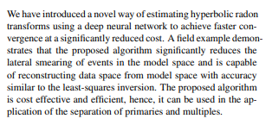
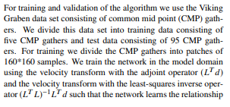
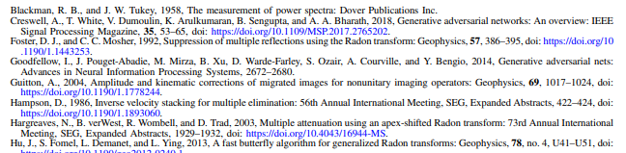
5. CONCLUSIONS
4.EXAMPLES
6.REFERENCES

Slide 10
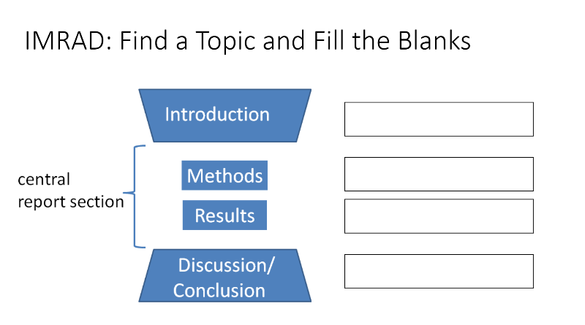
ABOUT LAST week

Slide 11

Assignment
Write a short article with the topic you chose
Use IMRAD to structure your paper
Due date: The start of Section 4;
please turn in printed copies
THANKS!

